Slide 1
Chapter 17
Avoiding Unnecessary Renders in React

Slide 2
Objectives
About the render Method
Optimizing render Calls
Getting an Example Going
Seeing the render Calls
Overriding a Component Update
Using PureComponent

Slide 3
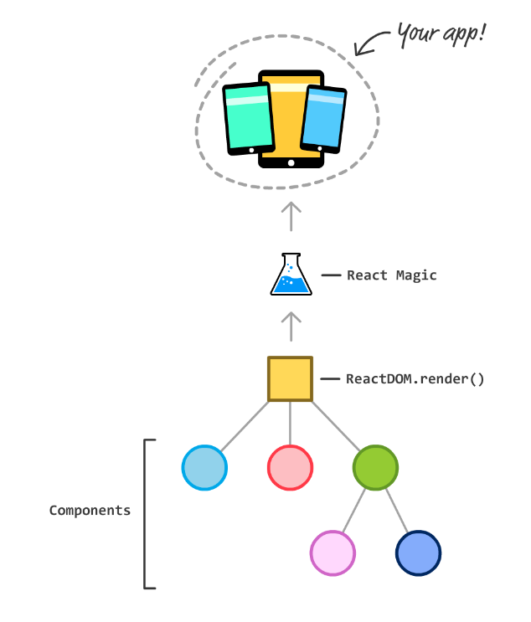
About the Render method
The render method's official job description is pretty simple. It just needs to show up on each component and help generate the JSX to return to whatever parent component called it. If we had to loosely describe the full workflow from components on one end and a fully finished app on the other end, it would look as follows:
Here are three things that will cause a render method to automatically get called:
A prop that lives on your component gets updated
A state property that lives on your component gets updated
A parent component's render method gets called

Slide 4
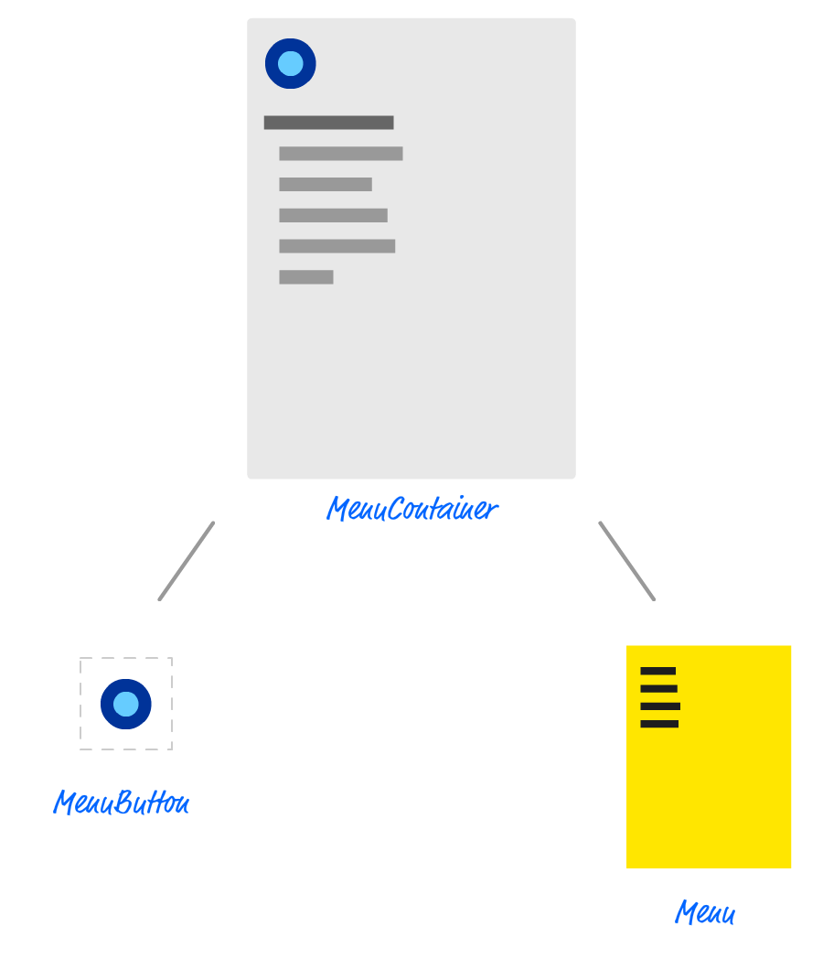
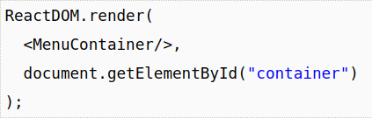
Optimizing Render Calls
Getting an Example Going
Looking at our example, to re-use a graphic you may have already seen, the component hierarchy for our sliding menu app looks as follows:
At the root we have MenuContainer, and it has two children - MenuButton and Menu. While not shown in the diagram, there is a ReactDOM.render call in index.js that exposes our MenuContainer to the DOM:

Slide 5
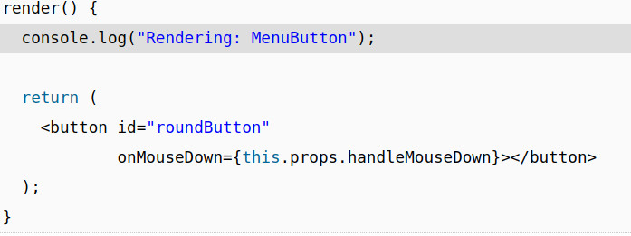
Seeing the Render Calls
The console.log approach is an easy one that we will use for now. In your code editor, open MenuContainer.js, MenuButton.js, and Menu.js and scroll down to each component's respective render method. At the very top of this method, we are going to add a console.log call.

Slide 6
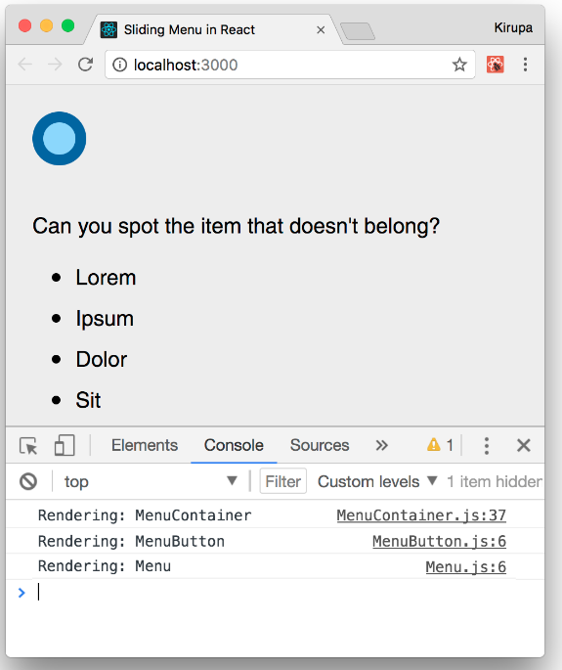
Seeing the Render Calls
Once you have added these three lines, run your app in your browser. Once the app is up and running, bring up your browser's developer tools and take a look at what is printed in the console:
Once you've done that, take a look at your console. You'll see the following new items (highlighted in green):
Rendering: MenuContainer
Rendering: MenuButton
Rendering: Menu
clicked
Rendering: MenuContainer
Rendering: MenuButton
Rendering: Menu

Slide 7
Overriding a Component Update
A while ago, we looked at the various lifecycle methods that React provides. One of them is shouldComponentUpdate. This method is called just prior to a render call from being made, and you can block the render method from being called by having our shouldComponentUpdate method return false. What we are going to do is use the shouldComponentUpdate method to do just that.
Once you have done this, refresh your app to test your code. Pay attention to the console, and see what gets printed when you are showing and hiding a menu. Your output when your page loads and the menu is displayed for the first time will now be as follows:
Rendering: MenuContainer
Rendering: MenuButton
Rendering: Menu
clicked
Rendering: MenuContainer
Rendering: Menu

Slide 8
Why not always use PureComponent?
The PureComponent seems pretty awesome, right? Why don't we just use it always and ditch Component altogether? You probably should! With that said, there are a few reasons that you may want to stick with Component.
First, what PureComponent does is perform what is known as a shallow comparison. It isn't a comprehensive check of everything that may have changed in your props or state between calls to re-render. For many cases, that is OK. For other cases, that may not be.
Second, besides the comparison logic, the bigger problem with using PureComponentis performance. Having each of your components check to see if props or state have changed, even if it is a shallow check, takes up some computation time.
TL;DR: This should probably have been mentioned at the top of this note, but what are you going to do? Basically, it's fine to use PureComponent instead of Component. Just be aware of the two (minor) side-effects.

Slide 9
Conclusion
Ensuring your app is performant requires constant vigilance. Profile your app's performance frequently, and definitely do so after each time you make a code change under the goal of optimizing performance.
Each performance optimization you make adds complexity that just adds to your (or your team's) overhead of maintaining the code and making fixes in it for the lifetime of your app's existence.
Be conscious of that and don't over-optimize. If your app works really well on the devices (especially the low-end ones) and browsers you are targeting, consider your job done.
Take a break and don't do any extra work...except maybe reading the next tutorial that introduces you to Redux!

